Slide 1
2014
Facts and Figures

Slide 2
General Information
Main Policy Areas and Services
Customer Satisfaction Survey

Slide 3
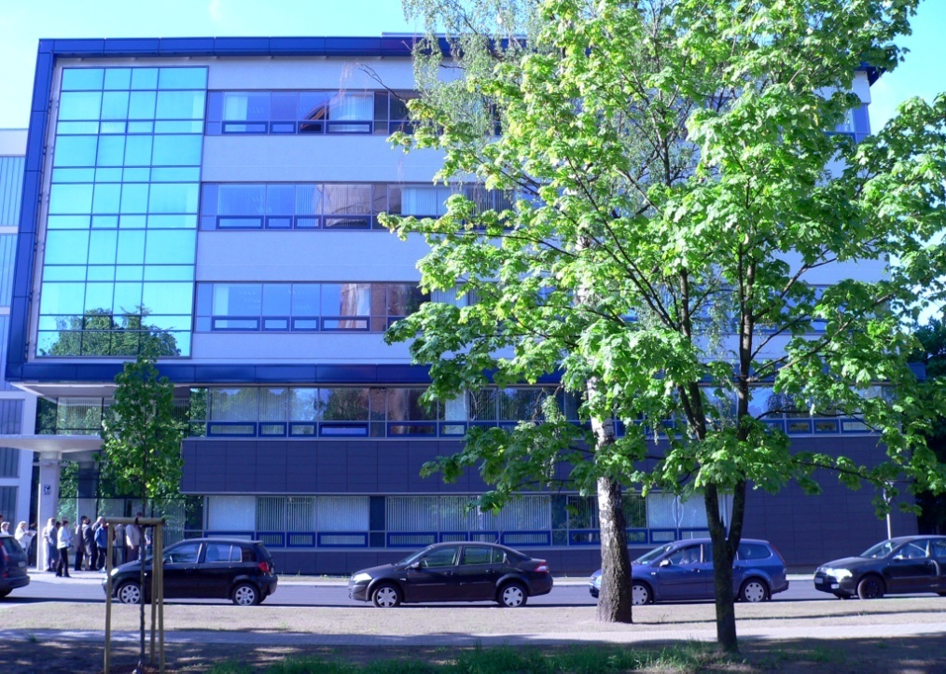
General Information
The Office of Citizenship and Migration Affairs
(hereinafter – OCMA) is a state institution under the supervision of the Minister of the Interior.
It implements state migration and asylum policy, determines the legal status of individuals in the country, keeps registers of residents, as well as issues identification and travel documents.

Slide 4
Organisation Structure

Slide 5
Personnel
Personnel
Personnel
Education Level
Personnel
Central and Regional Divisions
Number of Employees
Employees by Gender
General Information
Policy Areas

Slide 6
Personnel
With every year the requirements for the qualifications of the OCMA personnel are growing as the functions of the authorities under the Ministry of the Interior are expanding in the fields of migration and asylum as well as in the fields of IT and electronic services.
In 2014, the functions of the central structural units of the OCMA were optimised and reorganised.
As at December 31, 2014, the OCMA employed 676 persons.
Personnel

Slide 7
Personnel
Personnel

Slide 8
Personnel
Personnel

Slide 9
Personnel
Personnel

Slide 10
Personnel
When implementing the strategy of the OCMA, main tasks of the OCMA central divisions are:
elaboration of legal acts;
The tasks of the regional divisions are:
coordination and control of the activities of the regional divisions;
material and technical funding of the divisions within the budget;
updating of information systems
practical implementation of the functions determined in the Statute of the OCMA.
Personnel

Slide 11
Personnel
Policy making
Decision making
Granting/refusing
Registrating
Issuing
Controlling
Personnel

Slide 12
Regional Divisions
Valka
Limbaži
Valmiera
Alūksne
Ventspils
Smiltene
Cēsis
Talsi
Rīga (4)
Gulbene
Balvi
Kuldīga
Tukums
Jūrmala
Ogre
Madona
Saldus
Dobele
Jelgava
Liepāja
Aizkraukle
Ludza
Jēkabpils
Rēzekne
Līvāni
Preiļi
Bauska
Krāslava
Daugavpils
Personnel

Slide 13
Main Policy Areas
Migration
Asylum
Persons’
Legal Status
Population
Register
Identity
Documents

Slide 14
Services
Individuals are able to apply for and receive the services at any of the 30 regional divisions of the OCMA, irrespective of their officially declared place of residence, as well as at Consular or Diplomatic Missions of the Republic of Latvia abroad, if the individual happens to be outside Latvia.
Online data exchange services are provided to state institutions, municipal authorities; organisations and companies to which the functions of public administration are delegated, such as sworn notaries, banks, etc.
Electronic services are available to the public by using authentication with an electronic signature or through an internet banking facility at www.latvija.lv
and www.pmlp.gov.lv
On-Site Services
Electronic Services
Interinstitutional Services
Policy Areas

Slide 15
Services
Policy Areas

Slide 16
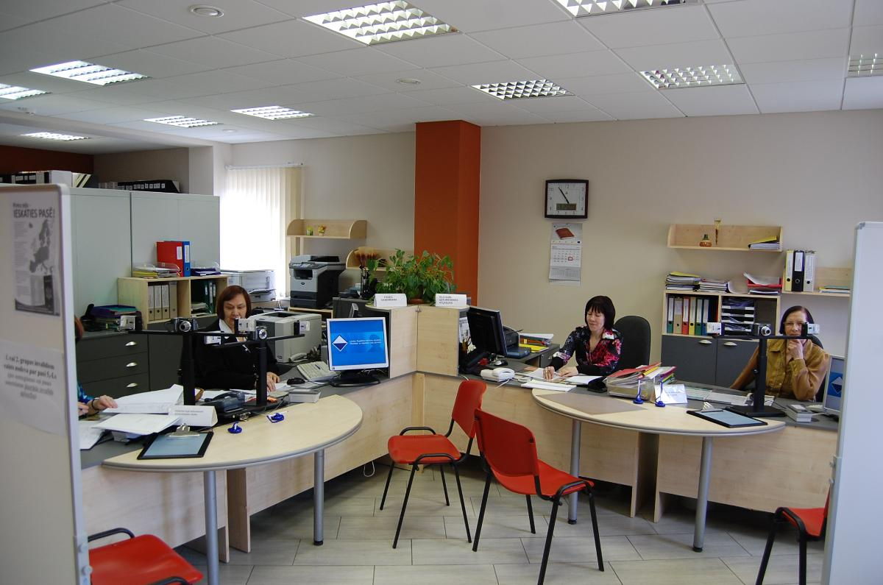
Services
Policy Areas

Slide 17
MIGRATION
Short term migration
Invitations
Visas
Long term migration
Residence Permits
Repatriation
Number of Repatriates
Repatriates’ Source Countries
Declaration of Residence
Removal
Work Permits
General Information
Policy Areas

Slide 18
Invitations
Pursuant to the provisions of the Immigration Law, invitation is a document approved by OCMA, in which an inviter undertakes the obligations specified in the Immigration Law in relation to the foreigner whom he or she has invited to reside in the Republic of Latvia (with a visa).
Migration

Slide 19
Invitations
Migration

Slide 20
Invitations
Migration

Slide 21
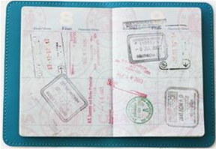
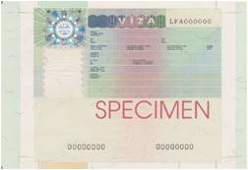
Visas
The foreigner who needs a visa in order to enter Latvia must claim for and obtain it prior to the entering - in one of the diplomatic or consular offices of the Republic of Latvia or embassy of other Schengen Member State representing Latvia or consulate according to the provisions of territorial responsibility. In exceptional cases, the visa can also be issued at border crossing points: if it is in accordance with the international legal norms, in the interests of the Latvian state or if it is connected with Force Majeure or humanitarian considerations.
One of the institutions that issue visas is also the OCMA. The number of visas issued by the OCMA is very small comparing to the number of visas issued by diplomatic and consular representation offices of the Republic of Latvia and border control points. It can be explained by the fact that the OCMA issues visas only in case if a foreigner needs extension of his or her stay in Latvia due to previously unforeseen circumstances and he or she is unable to leave the country by a date indicated in the visa.
Migration

Slide 22
Visas
Migration

Slide 23
Visas
Migration

Slide 24
Visas
Migration

Slide 25
Residence Permits
A residence permit is a document which gives a foreigner the right to reside in the Republic of Latvia.
A residence permit is required if a foreign national or a stateless person wishes to reside in the Republic of Latvia for more than 90 days within a 6-month period.
Two types of residence permit exist, a temporary residence permit (TRP) and a permanent residence permit (PRP).
Tasks of the OCMA include the issuing, registration and cancelling of residence permits and the issuing and cancelling of work permits.
To perform the said tasks efficiently, the OCMA cooperates with other involved government authorities– the State Border Guard, the Consular Department of the Ministry of Foreign Affairs, diplomatic and consular representation offices of Latvia abroad, the Ministry of Welfare, and the Employment State Agency.
Migration

Slide 26
Residence Permits
A foreigner has the right to request a temporary residence permit (TRP) in accordance with the procedures specified in the Immigration Law, if the contribution in equity capital of the capital company has been made in a specified amount, immovable property has been purchased in a specified value, or financial investments in the credit institution (subordinated capital –subordinated loan or subordinated bonds – of a credit institution) made in a specified amount.
Migration

Slide 27
Residence Permits
Migration

Slide 28
Residence Permits
Migration

Slide 29
Residence Permits
Migration

Slide 30
Residence Permits
Migration

Slide 31
Residence Permits
Migration

Slide 32
Residence Permits
Migration

Slide 33
Residence Permits
Migration

Slide 34
Residence Permits
Number of Valid TRP
(as of 1st of January) by Reason of Issue
Migration

Slide 35
Residence Permits
Number of Valid TRP
(as of 1st of January) by Reason of Issue
Migration

Slide 36
Residence Permits
Number of Valid TRP
(as of 1st of January) by Reason of Issue
Migration

Slide 37
Residence Permits
Migration

Slide 38
Residence Permits
Migration

Slide 39
Residence Permits
Migration

Slide 40
Residence Permits
Migration

Slide 41
Residence Permits
Migration

Slide 42
Residence Permits
Migration

Slide 43
Work Permits
Migration

Slide 44
Repatriation
According to the Repatriation Law, a repatriate is a person who is a Latvian citizen or one of whose parents or grandparents is a Latvian or a Liv and who voluntarily takes up permanent residence in the Republic of Latvia.
The repatriates who were forced to leave Latvia prior to May 4, 1990 have the right to receive the state aid to cover travel expenses, the material assistance in the case of unemployment and to bring in their property exempt from the customs duties and taxes.
Pursuant to the Repatriation Law, the OCMA makes decisions on granting or cancelling the status of repatriate, issues documents to repatriates, informs repatriates on their social rights and guaranties available to them and, in cooperation with local governments, helps repatriate families solve adaptation and integration issues.
Material assistance to repatriates (travel expenses, unemployment benefits or language training courses) in 2014 comprised 550 allowances for the total amount of EUR 96 078.
Migration

Slide 45
Repatriation
Migration

Slide 46
Repatriatiates’ Source Countries 2003-2014
Czech Republic | 3
Greece | 3
Philippines | 3
Azerbaijan | 3
Mexico | 2
New Zealand | 2
Nepal | 2
Switzerland | 2
Netherlands | 1
Belgium | 1
Italy | 1
Uruguay | 1
Serbia | 1
Total | 2 018
Kazakhstan | 28
Uzbekistan | 23
Brasil | 18
Estonia | 16
Georgia | 15
Venezuela | 14
Sweden | 13
Turkmenistan | 10
Armenia | 9
Kyrgyzstan | 8
France | 6
Cuba | 5
Spain | 4
Country
Russia | 938
Ukraine | 255
USA | 241
Belarus | 94
Canada | 59
Germany | 50
Lithuania | 49
Israel | 39
Australia | 36
Moldova | 36
UK | 27
Migration

Slide 47
Repatriation
Migration

Slide 48
Official Residences Declared
Since January 1, 2010, foreigners are able to declare the place of residence simultaneously with receiving of the residence permit in the regional divisions of the OCMA.
Migration

Slide 49
Removal
The procedures by which foreigner enter, reside, transit, exit, are detained as well as the procedures by which foreigners are held under guard in the Republic of Latvia and are expelled from it in order to ensure the implementation of migration policy conforming with the norms of international law and the State interests of Latvia are determined in the Immigration Law.
To ensure the implementation of migration policy according to the international law and interests of Latvia, on the basis of the Immigration Law, the OCMA issues the return decisions or takes decisions on removal if a foreigner during his/her stay in Latvia has violated the procedure for entry or residence of foreigners, for example, he/she has ignored a period of stay indicated in a visa, resides without valid visa or residence permit or he/she has breached the terms of non –visa regime, and in other cases.
The Voluntary return decision requests an foreigner to leave the Republic of Latvia within a period of seven to 30 days. When a return decision is issued the prohibition to enter the Republic of Latvia for a period up to 3 years can be imposed.
Removal order determines prohibition to enter the Republic of Latvia for a period up to three years. Forced return of a foreigner is carried out by the State Border Guard.
Migration

Slide 50
Removal
Migration

Slide 51
ASYLUM
Asylum
Asylum Seekers
Refugees, Alternative Status
Asylum
Asylum Seekers’ Accommodation Centre
Asylum
Asylum Seekers’ Source Countries
Dublin Regulation
Policy Areas

Slide 52
Asylum
Asylum seeker is a third country national or a stateless person who, in accordance with the procedures specified in the Asylum Law, has submitted an application regarding granting of refugee or alternative status in the Republic of Latvia until the time when the final decision regarding his or her application has come into effect and become non-disputable.
The refugee status may be granted if the person is justifiably afraid of persecution in their citizenship country or previous host country (stateless persons) due to their racial, religious, national or social identity or political beliefs.
A third country national or a stateless person who cannot be granted refugee status may apply for alternative status if there is a reason to believe that he or she may be exposed to serious harm after return to the country of origin thereof and due to this reason is unable or does not wish to accept the protection of the referred to country.
Since 1998, when the asylum procedure was implemented, in total 1440 persons have applied for asylum; of them, 65 have received the refugee status and 125 have received the alternative status. In this period, four of the persons who have received the refugee status or the alternative status, have passed naturalisation and become citizens of Latvia.
Asylum

Slide 53
Asylum Seekers
Asylum

Slide 54
Asylum Seekers
Asylum

Slide 55
Asylum Seekers
Asylum

Slide 56
Asylum Seekers’ Countries of Origin 1998-2014
Georgia | 623
Russia | 102
Syria | 88
Ukraine | 85
Afghanistan | 82
Republic of the Congo | 72
Iraq | 48
Armenia | 34
Uzbekistan | 23
Iran | 21
Vietnam | 19
Azerbaijan | 17
Egypt | 17
Belarus | 17
Pakistan | 14
Cameroon | 14
Bangladesh | 13
Turkey | 12
Kyrgyzstan | 12
Algeria | 12
Lebanon | 10
Palestine | 9
Slovakia | 9
Somali | 9
Sri Lanka | 8
Cuba | 7
Ghana | 7
Nigeria | 7
Cote d I’voire | 6
Kazakhstan | 5
Tajikistan | 4
Angola | 3
Morocco | 3
Stateless | 2
Eritrea | 2
Guinea | 2
Kenya | 2
Congo | 2
Libya | 2
Mongolia | 2
Haiti | 1
Benina | 1
Zimbabwe | 1
India | 1
Japan | 1
Colombia | 1
Lithuania | 1
Moldova | 1
Nepal | 1
Romania | 1
Senegal | 1
Serbia | 1
Sierra Leone | 1
Sudan | 1
Total 1 440
Asylum

Slide 57
Dublin Regulation
When Latvia accessed to the European Union on 1 May 2004, Council Regulation (EC) No 343/2003 of 18 February 2003 establishing the criteria and mechanisms for determining the Member State responsible for examining an asylum application lodged in one of the Member States by a third-country national became binding in Latvia (Dublin Regulation).
The main objective of the Dublin Regulation is to ensure that the application of an asylum seeker is only viewed in one EU Member State to prevent cases where the asylum seekers and/or their family lodge asylum requests in several EU Member States simultaneously, in this way abusing the asylum procedure. The Dublin Regulation sets out the criteria which are used by the Member State to assess whether another EU Member State is responsible for viewing a particular asylum application.
Asylum

Slide 58
Dublin Regulation

Slide 59
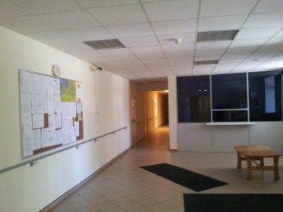
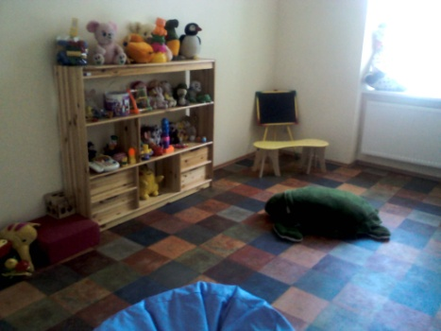
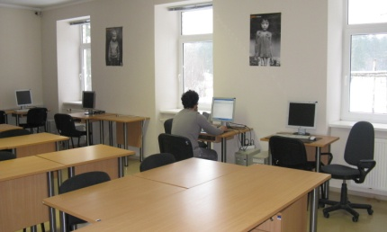
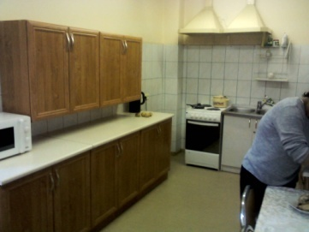
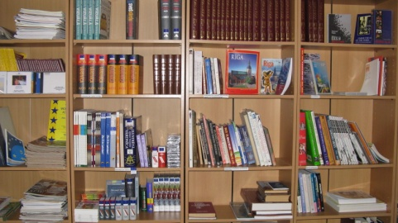
Asylum Seekers’ Accommodation Centre
In accordance with the international practice, in 1997 Latvia commenced the work on creating the Asylum Seekers’ Accommodation Centre Mucenieki. The Centre is located in Ropaži Civil Parish in Mucenieki, 17 kilometres from Rīga, in a former Soviet Army military base. The Centre’s creation was supported by the US Government, the United Nations High Commissioner for Refugees (UNHCR) and the Swedish Government.
The Centre can accommodate 200 people; its main task is to provide accommodation to asylum seekers while their cases are being viewed and decided on and to facilitate their adaptation in the society of Latvia.
In 2014, in total 261 persons have lived in the Centre.
Asylum

Slide 60
PERSONS’ LEGAL STATUS
Legal
Status
Determination of Legal Status
Legal Status
Acquisition of Citizenship
Legal
Status
Losing of Status of Non-citizen
Losing of Status of Citizen
Policy Areas

Slide 61
Persons’ Legal Status
If data of the person are not included in the Population Register and no identity number has been assigned to the person, the legal status of the person in the country has to be determined. Without the status and the identity number, persons cannot receive personal identification documents, work legally, receive allowances and other services.
The OCMA determines the belonging of persons to:
the aggregate of Latvian citizens according to the Citizenship Law;
the aggregate of Latvian non–citizens according to the conditions set out in the Law On the Status of those Former U.S.S.R. Citizens who do not have the Citizenship of Latvia or that of any Other State;
the aggregate of stateless persons according to the conditions set out in the Law On Stateless Persons.
Legal Status

Slide 62
Persons’ Legal Status
Non-citizens of Latvia are such citizens of the former USSR who reside in the Republic of Latvia as well as who are in temporary absence and their children who simultaneously comply with the following conditions:
1) on 1 July 1992 they were registered in the territory of Latvia regardless of the status of the living space indicated in the registration of residence, or up to 1 July 1992 their last registered place of residence was in the Republic of Latvia, or it has been determined by a court judgment that they have resided in the territory of Latvia for 10 consecutive years until the referred to date;
2) they are not citizens of Latvia; and
3) they are not and have not been citizens of another state.
The legal status of the persons who have immigrated into the Republic of Latvia after 1 July 1992 is determined by the Immigration Law .
Legal Status

Slide 63
Persons’ Legal Status
Legal Status

Slide 64
Acquisition of Citizenship
Legal Status

Slide 65
Acquisition of Citizenship
Legal Status

Slide 66
Acquisition of Citizenship
Legal Status

Slide 67
Acquisition of Citizenship
Legal Status

Slide 68
Acquisition of Citizenship
Legal Status

Slide 69
Acquisition of Citizenship
Legal Status

Slide 70
Acquisition of Citizenship
Recognition as a Latvian Citizen of a Child of Stateless Person or Non-citizen Born in Latvia after 21 August 1991
A child who has not been recognised as a Latvian citizen concurrently with the registration of the child’s birth fact on the basis of the volition expressed by one of the parents shall be recognised as a Latvian citizen until reaching 15 years of age on the basis of an application by one of the parents.
Legal Status

Slide 71
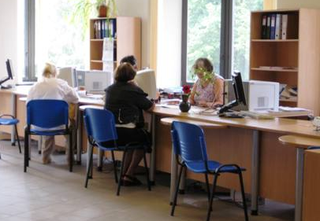
Loss of Latvian Citizenship
The OCMA views applications for renunciation of Latvian citizenship. In total 182 persons have renounced the citizenship of Latvia in 2014.
Similarly, the OCMA views the cases for revocation of Latvian citizenship. 106 claims for revoking of the citizenship of Latvia have been presented to court. 20 rulings on the revoking entered into force in 2014.
Legal Status

Slide 72
Loss of Latvian Citizenship
Renunciation of Latvian Citizenship
A citizen of Latvia who is also a citizen of another country or for whom citizenship of another country is being guaranteed, has the right to renounce Latvian citizenship.
A citizen of Latvia who has obtained citizenship of another country has an obligation to submit an application for renunciation of Latvian citizenship within 30 days after acquisition of citizenship of another country. This obligation shall not apply to a citizen of Latvia for whom Latvian citizenship is retained in accordance with Citizenship Law.
Latvian Citizenship may be Revoked for a Person, if he or she:
-has acquired citizenship of another country without submitting an application for renunciation of Latvian citizenship;
-is serving voluntarily in the armed forces or military organisation of another country;
-has intentionally provided false information or concealed the facts that apply to the conditions for the acquisition or restoration of Latvian citizenship;
-has committed an action promoting violent overthrow of the government of the Republic of Latvia.
Legal Status

Slide 73
Loss of Latvian Citizenship
Legal Status

Slide 74
Loss of Non-citizen Status
The OCMA also deals with cases of losing the status of non-citizen. A reason for the loss of non-citizen status may be renunciation of the non-citizen status, revocation of the non-citizen status or acquisition of the citizenship of Latvia.
Renunciation of Non-citizen Status
Any person who has acquired the citizenship (nationality) of another state has a duty to renounce the non-citizen status within 30 days after acquiring such citizenship.
Any person who is granted the citizenship (nationality) of any state or who has been issued a travelling document of any foreign state has the right to renounce the status of a non-citizen.
The Non-citizen Status of a Person shall be Revoked if he or she:
-has acquired the citizenship of another state without presenting a submission regarding the renunciation of the non-citizen status within 30 days after acquiring such citizenship;
-serves in the armed forces, internal security force, security service, police of any foreign state, or is in the service of judicial institutions without permission of the Cabinet of Ministers;
-has knowingly provided false information regarding himself or herself in order to acquire non-citizen status.
Legal Status

Slide 75
Loss of Non-citizen Status
Number of residents, who want to renounce the non-citizen status and to acquire the citizenship of the Russian Federation and to still remain in Latvia, tends to increase.
Mostly the economic benefit (chance to retire earlier, social guarantees), as well as the non-existence of obstacles to enter Russia (Latvian citizens need a visa) are mentioned as a reason for the choice.
In 2014, 2825 persons applied for renunciation of the non-citizen status, and the status was revoked for 110 persons.
Legal Status

Slide 76
Loss of Non-citizen Status
Legal Status

Slide 77
IDENTITY DOCUMENTS
ID Documents
ID Documents
ID Documents for Citizens
ID Documents for Non-citizens
ID Documents
ID Documents for Stateless Persons
ID Documents for Refugees
ID Documents in Total
General Information
Policy Areas

Slide 78
Identity Documents
To ensure the issuing of identification (ID) and travel documents, the OCMA performs the following tasks:
-issues identification documents to Latvian citizens and Latvian non-citizens, travel documents to refugees, persons whom the alternative status is granted and stateless persons who have received the permit to reside Latvia.
-accepts applications by the participants of national resistance movements and the politically repressed persons and issues identity cards for the participants of national resistance movements and the politically repressed persons.
ID documents

Slide 79
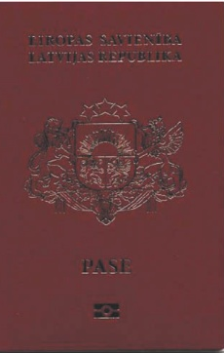
Identity Documents
Citizen’s passport is a person’s identity document issued to the citizens of the Republic of Latvia according to the data provided by the Population Register.
ID documents

Slide 80
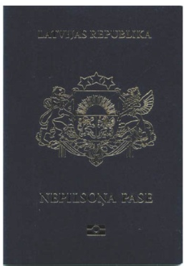
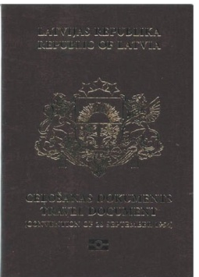
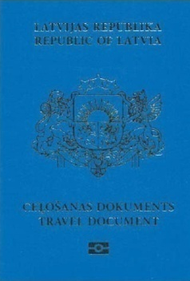
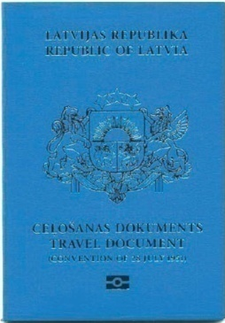
Identity Documents
Non-citizen's (alien’s) passport is a person’s identity document, ensuring its holder the rights to reside in the territory of Latvia, travel abroad, as well as other rights.
Stateless person’s travel document is a person’s identification document, issued by authorized state institutions, which according to the international agreements binding to Latvia, existing laws an other normative acts entitles the document’s holder to reside in the Republic of Latvia and travel abroad.
Refugee’s travel document confirms the identity of its holder and is envisaged for travelling abroad. It is issued to persons who have been granted the refugee status according to Asylum Law.
Travel document (for person with alternative status) confirms the identity of its holder and is envisaged for travelling abroad. It is issued to a person who has been granted the alternative status according to Asylum Law and who has no valid travel document issued by his/her country of citizenship and it is impossible to receive it.
ID documents

Slide 81
Identity Documents
ID documents

Slide 82
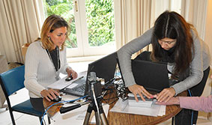
Identity Documents
ID documents

Slide 83
Identity Documents
ID documents

Slide 84
Identity Documents
ID documents

Slide 85
Identity Documents
ID documents

Slide 86
Identity Documents
ID documents

Slide 87
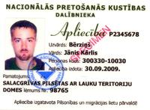
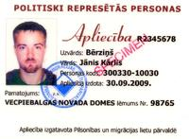
Identity Documents
ID documents

Slide 88
Identity Documents
ID documents

Slide 89
Identity Documents
ID documents

Slide 90
Identity Documents
ID documents

Slide 91
Identity Documents
ID documents

Slide 92
Population register
Population Register
Declaration of Residence
Population Register
Population Register
Population Register Statistics
Information from the Population Register
Electronic Services
Data Exchange Systems
General Information
Transferred Letters
Policy Areas

Slide 93
Population Register
The main task of the Population Register is to ensure the records of Latvian citizens, Latvian non-citizens, as well as of foreigners, stateless persons and refugees who have received residence permits in Latvia, in accordance with the procedures specified in the Population Register Law by including and updating information in the Register regarding such persons.
Within the scope of their competence, the OCMA and foreign diplomatic and consular representations of Latvia abroad are responsible for the inclusion of information in the Population Register.
The Population Register is one of the most significant databases of national level; it contains information on more than three million persons. The Population Register is a single country’s population registration system where information is gathered on names, marittal status, residence, personal identification documents etc.
The Population Register is the only national-level register where information online is used by all other national registers. The Population Register is also used to ensure the operation of e-administration and e-services too.
The information is used for statistical surveys, tax estimates and calculations, organizing of elections and other processes of national scale.
Population Register

Slide 94
Population Register
Population Register

Slide 95
Declaration of Residence
The place of residence can be declared in the relevant authority of the local government where the new place of residence of the person is located or electronically- by using the electronic residence declaration service at www.latvija.lv
Since January 1, 2010, the OCMA does not declare the person’s place of residence by post.
The reason why the number of declarations submitted electronically increases is explained by the perfection and improvement of the service availability. It is possible to receive the electronic service also by using internet banking facility.
Population Register

Slide 96
Declaration of Residence
Population Register

Slide 97
Information from the Register
The OCMA is issuing statements from the Population Register (about the place of residence of a person, his/her marital status, passport details and other information included in the Population Register).
A person may receive information about himself/herself or a person the legal or authorised representative of whom he/she is.
Individuals and legal entities may receive information about another person based on a motivated application.
Population register

Slide 98
Information from the Register
Population Register

Slide 99
Transferred Letters
Personal Data Protection Law prohibits the OCMA to disclose any details from the Population Register about another person, with the exception of cases when the wanted person has given his or her consent to the same.
The person who is searching for a wanted person shall submit a beforehand prepared written message. The OCMA transfers the written message to the address of the wanted person’s declared place of residence, on which the data are entered in the Population Register. Upon receipt of the information from the OCMA, the wanted person will by him/ herself decide whether to response to the calling of the demander.
Population register

Slide 100
Electronic Services
Electronic services, that are available to the public by using authentication with secure electronic signature or authentication means of the Internet banks:
Population register

Slide 101
Electronic Services
Submission of residence declaration: this service can be used to declare the residence of the person, their underage children or persons in their custody or dependent persons in Latvia.
Persons declared at my property: this service enables private individuals to find out information about their properties registered in the Land Register and the people who have declared their place of residence at the addresses of these properties.
My data or data of persons represented by me in the Population Register: this service can be used to find out what information on the person, their underage children or persons in their custody or dependent persons are included in the Population Register.
Population register

Slide 102
Electronic Services
Check whether the person has valid registration of residence at the specific address: this service can be used to find out in the Population Register whether the person with the specified identity number has valid residence registration at the specified address.
Application for prohibiting or permitting the use of person’s body, tissues and organs after death: with this service, persons can notify to the Office of Citizenship and Migration Affairs their prohibition or permission to use their body, tissues and organs after their death.
Checking whether the person is listed in the Population register and there is no information on person’s death: this service enables checking whether the person is listed in the Population Register, and if they are, that there is no information on the death of the person.
Population Register

Slide 103
Electronic Services
Application for registering residence abroad: this service can be used to declare to the OCMA the residence address of the person, their underage children or persons in their custody or dependent persons abroad.
Application for statement from the Population Register on the person or a represented person: this service can be used by persons to request information that is included in the Population Register on oneself, their underage children or persons in their custody or dependent persons.
Application for statement from the Population Register on a third person: this service can be used by persons to request information that is included in the Population Register on third persons.
Population Register

Slide 104
Population Register
Population Register

Slide 105
Population Register Statistics
Germany | 1 942
Uzbekistan | 1 414
China | 1 200
Estonia | 1 103
Bulgaria | 816
Kazakhstan | 737
Sweeden | 731
UK | 672
Poland | 591
USA | 562
Azerbaijan | 506
Italy | 472
France | 431
Finland | 386
India | 365
Israel | 360
Norway | 326
Armenia | 316
Georgia | 307
Other (<300 each) | 4 177
Total | 2 160 297
Population of the LR by Nationality (01.01.2015)
Latvia (citizen) | 1 813 466
Latvia (non-citizen) | 262 622
Russia | 54 838
Ukraine | 4 853
Lithuania | 4 356
Belarus | 2 748
Population Register

Slide 106
Population Register Statistics
Population Register

Slide 107
Population Register Statistics
Population Register

Slide 108
Population Register Statistics
Population Register

Slide 109
Population Register Statistics
Population Register

Slide 110
Population Register Statistics
Population Register

Slide 111
Population Register Statistics
Population Register

Slide 112
Population Register Statistics
Population Register

Slide 113
Customer Satisfaction Survey (2014)

Slide 114
Customer Satisfaction Survey (2014)

Slide 115
Customer Satisfaction Survey (2014)
On average, min=1, max=6

Slide 116
Customer Satisfaction Survey (2014)
On average, min=1, max=6

Slide 117
Customer Satisfaction Survey (2014)

Slide 118
Customer Satisfaction Survey (2014)

Slide 119
Čiekurkalna 1. līnija 1/3
Rīga, LV 1026
Latvia
tel. (+371) 672 19183
fax. (+371) 678 29825
pmlp@pmlp.gov.lv
www.pmlp.gov.lv

